Slide 1
MEET ME AT THE INTERSECTION
ARNOLD
MIRE FDE
MIRE FDE
ARNOLD
Sharon Hawkins – GIS and Mapping Section
Notes:
Thank You! Glad to be a part of this presentation today and share a little bit about our Intersection Manager experience. At GIS-T 2017 in Phoenix, AZ we saw a very similar presentation to what Jessie and Lauren had just given. From everything we knew about the MIRE FDE intersections requirements, this tool seemed like it would offer us the dynamic, organized, and easily maintainable environment that we had been wanting for our intersection program. Notice that the title slide shows the intersection of ARNOLD and MIRE FDE. It is imperative to our methodology that the ARNOLD dataset be the foundation for our intersections. Intersections have to be just as dynamic and able to “roll with the changes” as ARNOLD is. Let’s dig in!

Slide 2
MIRE
MIRE – Model Inventory of Roadway Elements
Recommended listing of road inventory and
traffic elements critical to safety management (205)
MAP 21 and the FAST Act established a subset (37) of the 205
elements to ensure that States improve data collection
these are called MIRE Fundamental Data Elements (FDEs)
All States must have the MIRE FDEs collected for
Non-local (State Maintained) routes
Notes:
Thank You! Glad to be a part of this presentation today and share a little bit about our Intersection Manager experience. At GIS-T 2017 in Phoenix, AZ we saw a very similar presentation to what Jessie and Lauren had just given. From everything we knew about the MIRE FDE intersections requirements, this tool seemed like it would offer us the dynamic, organized, and easily maintainable environment that we had been wanting for our intersection program. Notice that the title slide shows the intersection of ARNOLD and MIRE FDE. It is imperative to our methodology that the ARNOLD dataset be the foundation for our intersections. Intersections have to be just as dynamic and able to “roll with the changes” as ARNOLD is. Let’s dig in!

Slide 3
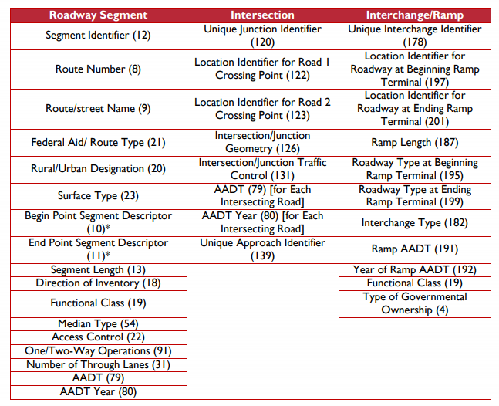
MIRE FDEs
Notes:
Thank You! Glad to be a part of this presentation today and share a little bit about our Intersection Manager experience. At GIS-T 2017 in Phoenix, AZ we saw a very similar presentation to what Jessie and Lauren had just given. From everything we knew about the MIRE FDE intersections requirements, this tool seemed like it would offer us the dynamic, organized, and easily maintainable environment that we had been wanting for our intersection program. Notice that the title slide shows the intersection of ARNOLD and MIRE FDE. It is imperative to our methodology that the ARNOLD dataset be the foundation for our intersections. Intersections have to be just as dynamic and able to “roll with the changes” as ARNOLD is. Let’s dig in!

Slide 4
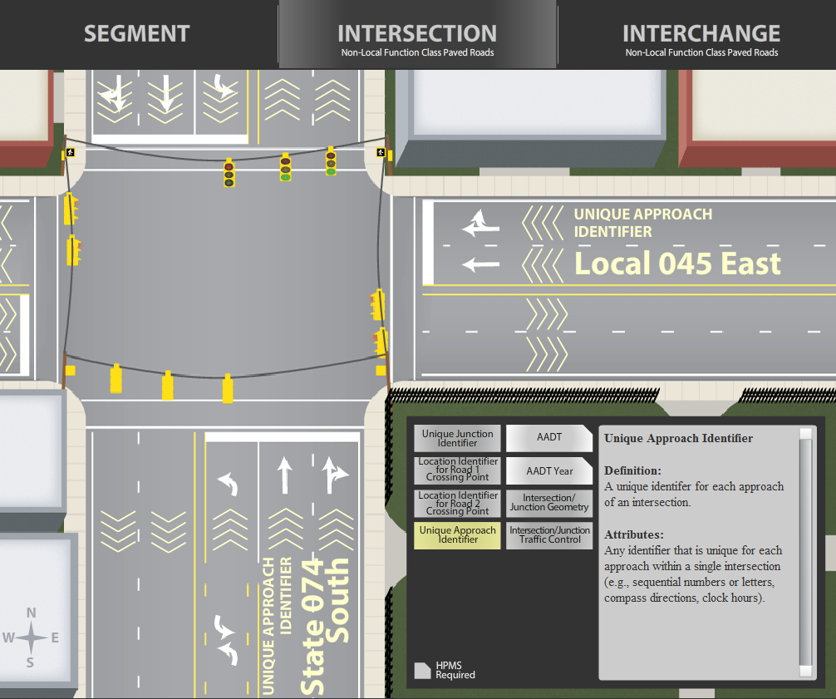
VISUAL MIRE
https://safety.fhwa.dot.gov/fde/illustrations.html
Notes:
I always like to show this graphic/website when I am talking about ARDOT’s intersection process or our MIRE FDE process overall. From the office of safety at FHWA, this website offers a structured explanation and visual aid for the 37 MIRE FDE requirements under the three main categories: Segment, Intersection, and Interchange. Referencing this website when talking to co-workers or managers about the expectations for intersections has been extremely helpful. If you haven't seen this website, I encourage you to check it out.

Slide 5
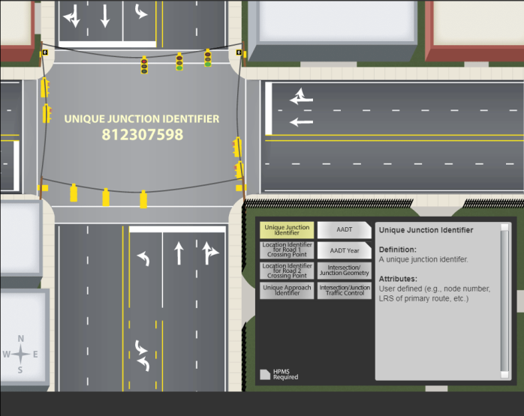
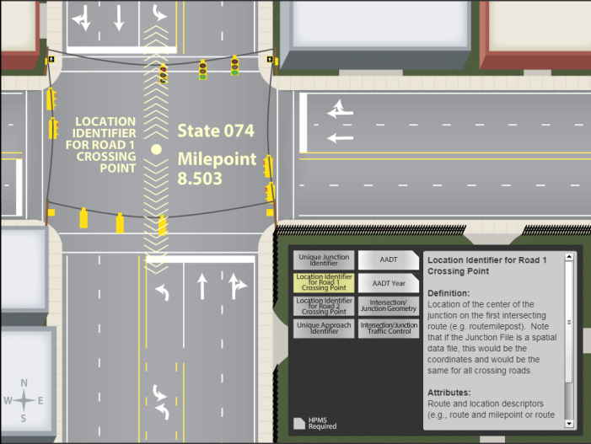
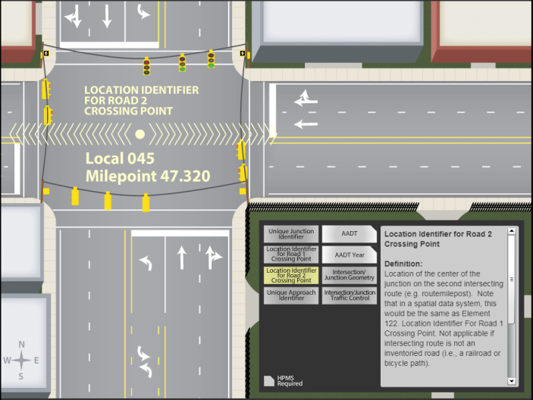
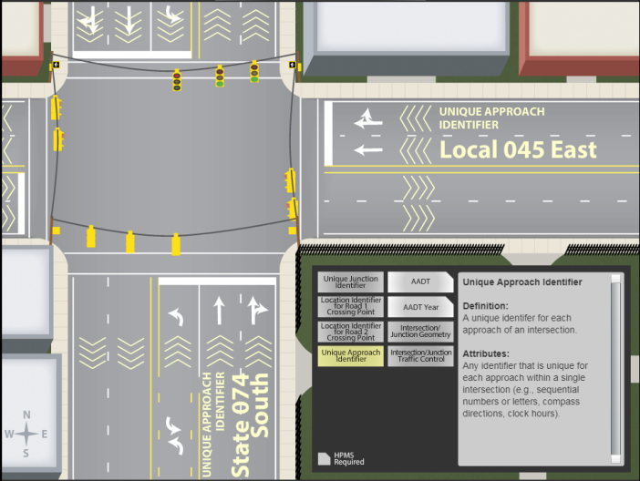
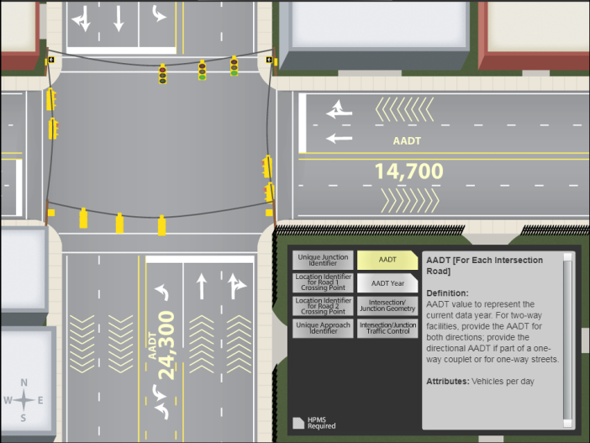
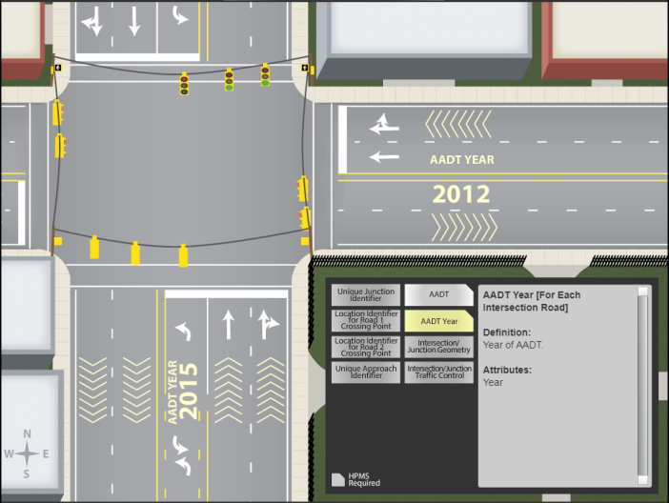
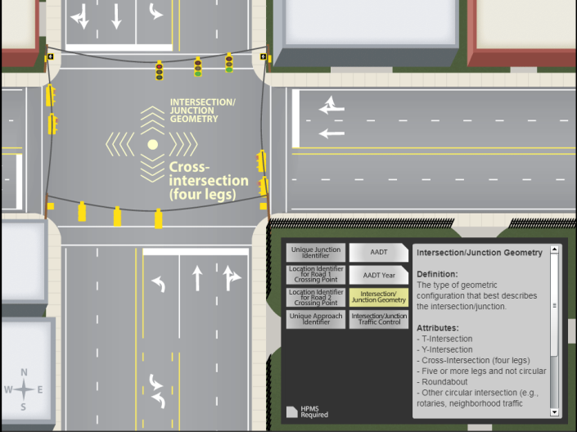
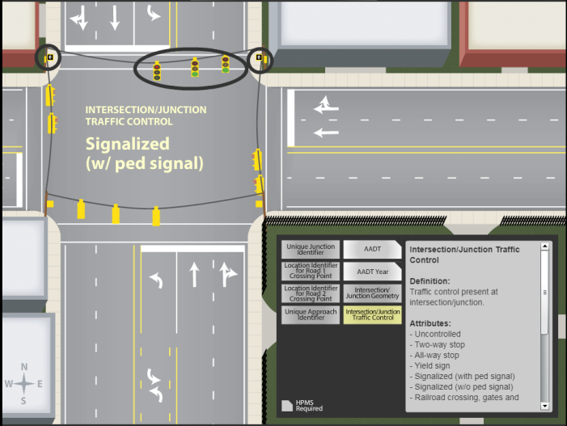
1
2
3
4
5
6
7
8
Notes:
These are the 8 required data elements for Intersections. When we were approaching our administration about the Intersection Manager tool, this was a great way for them to digest the value of having a tool like Intersection Manager or simply letting them see an overview of the FDE requirement overall.

Slide 6
MIRE NEEDS ARNOLD
2012 FHWA Memorandum
Beginning June 15, 2014 States must:
Include ALL ROADS NETWORK OF LINEAR REFERENCED DATA
in their Linear Referencing System (LRS) networks
Certified public road mileage validated by LRS
All segments must have a Paved/Unpaved attribute
Use DUAL CARRIAGEWAY representation for divided routes

Slide 7
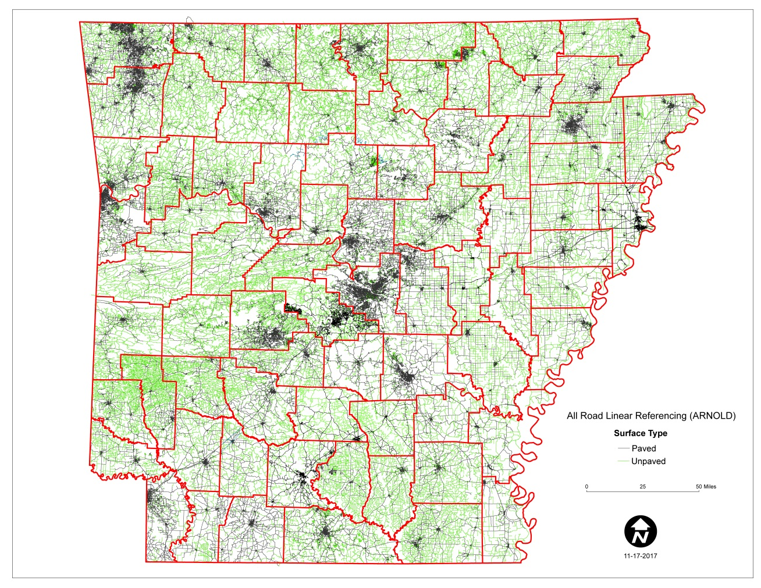
CURRENT STATUS – “Completed” Dec. 2017
105,627+ miles of road centerlines
Dual Carriageway for Divided Routes
All Ramps (at-grade & grade separated attribute)
All Frontage Roads
All Institutional Routes
All DOT Facilities (Rest Areas, Welcome Centers)
Paved/Unpaved Attribute
Ownership

Slide 8
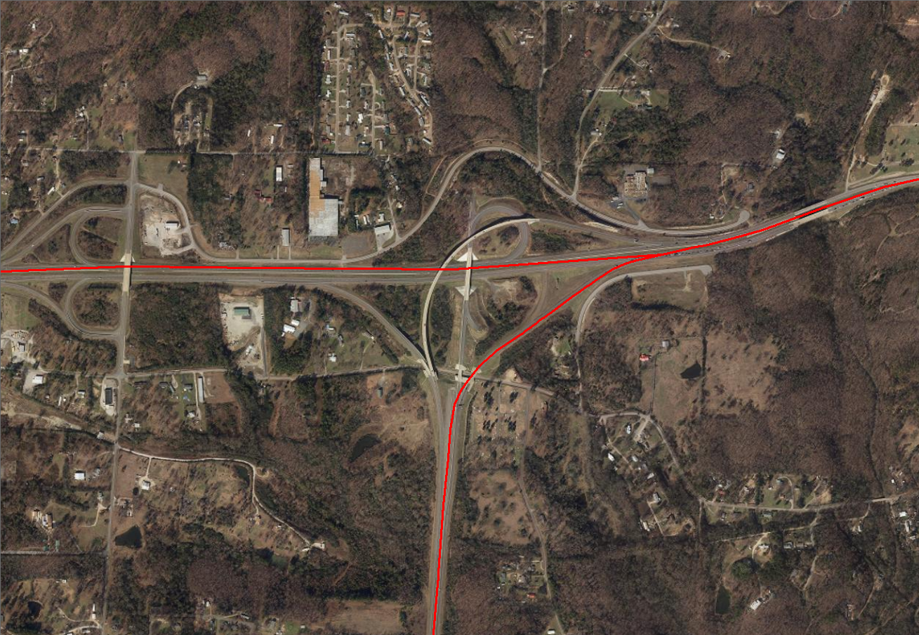
A CLOSER LOOK…Then and Now
Road Edition
US 70/US 70 B - HS

Slide 9
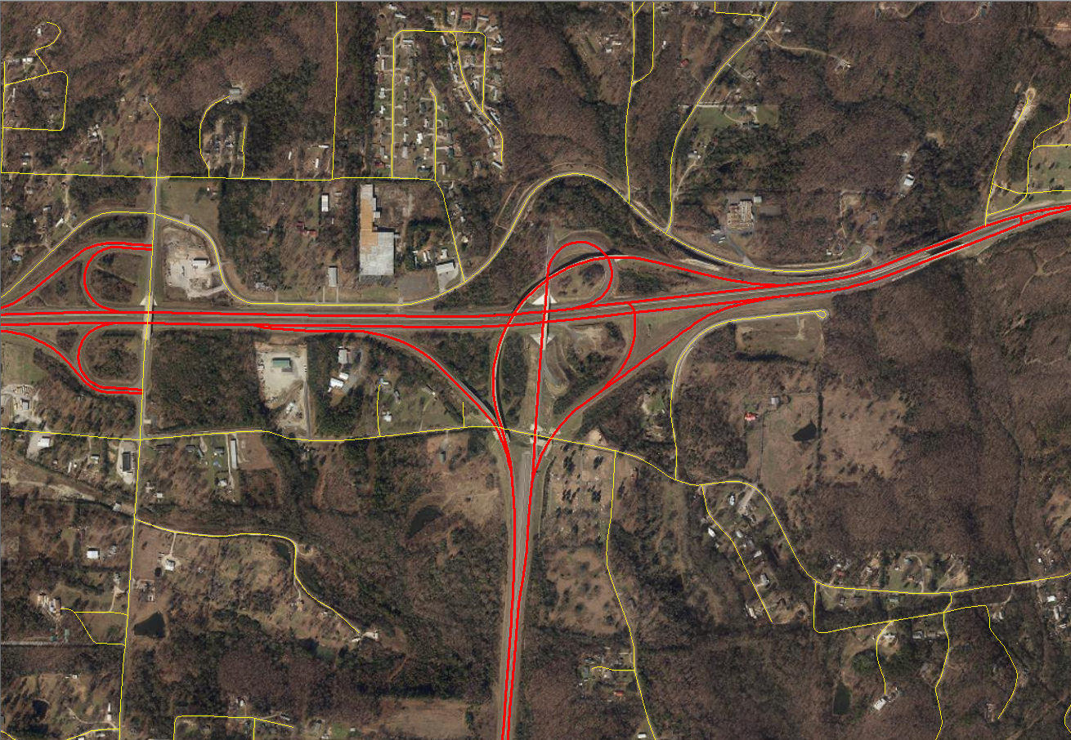
A CLOSER LOOK…Then and Now
Road Edition
US 70/US 70 B - HS

Slide 10
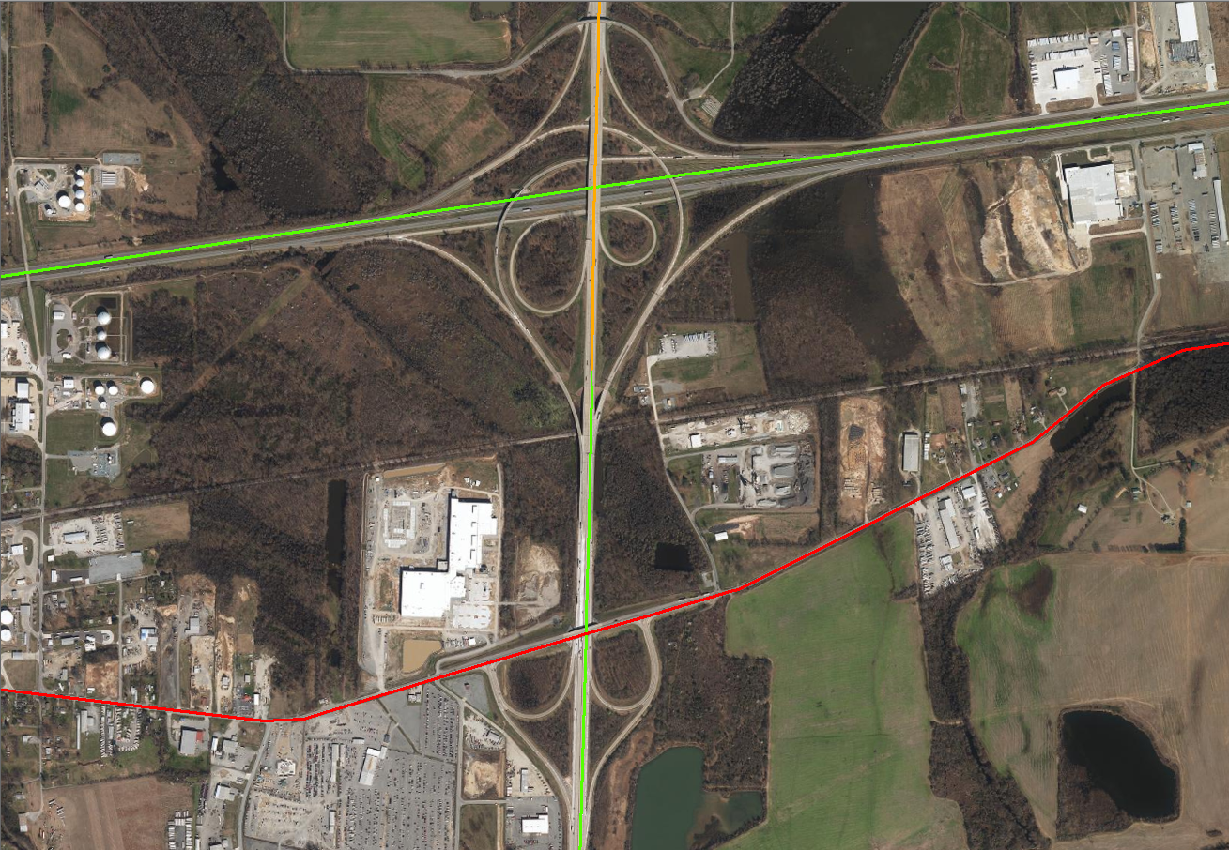
A CLOSER LOOK…Then and Now
Road Edition
I-40/I-440 - NLR

Slide 11
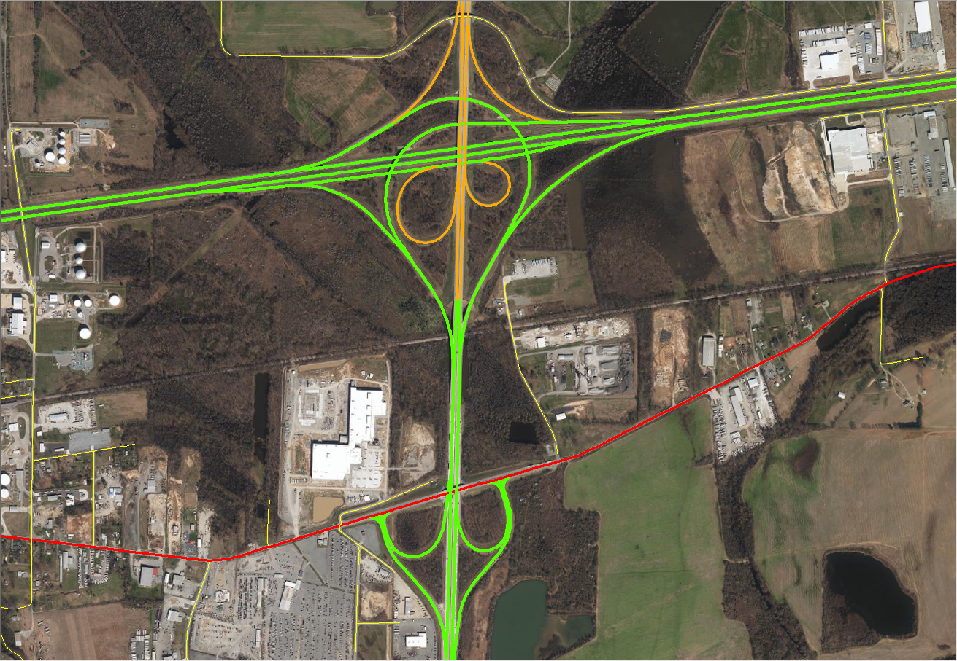
A CLOSER LOOK…Then and Now
Road Edition
I-40/I-440 - NLR

Slide 12
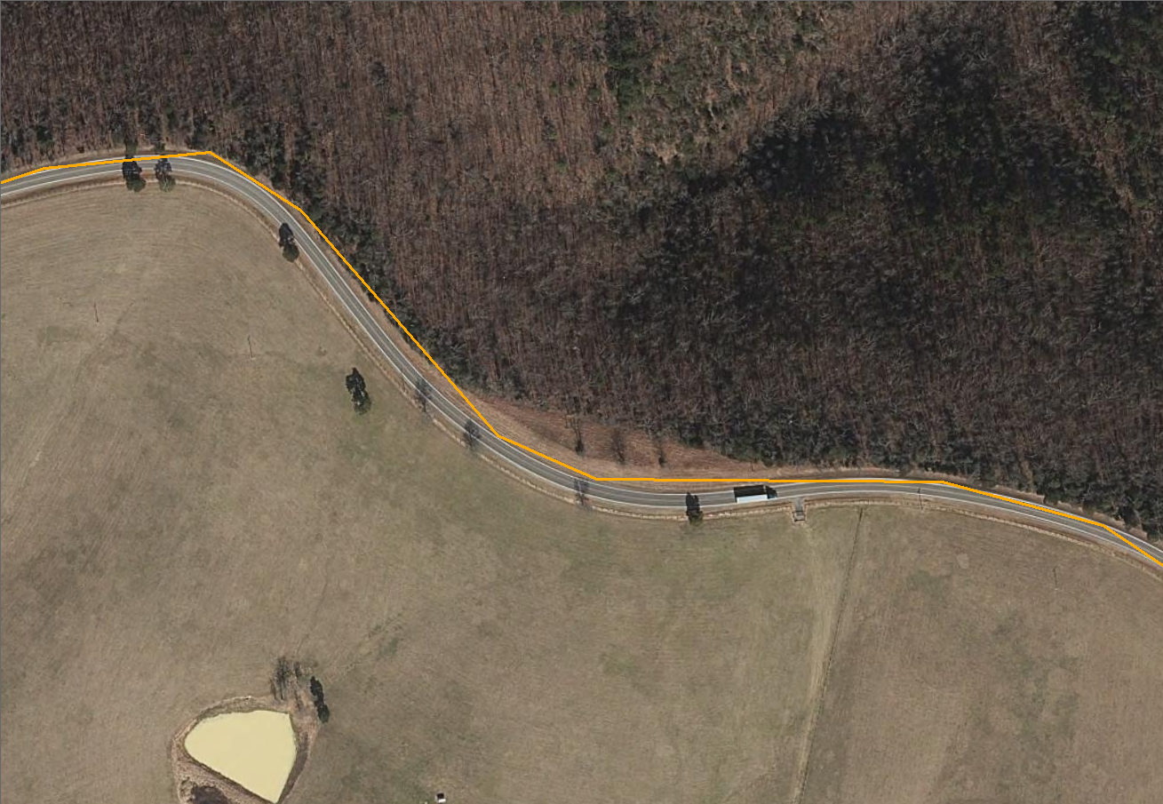
A CLOSER LOOK…Then and Now
Road Edition
SOMEWHERE

Slide 13
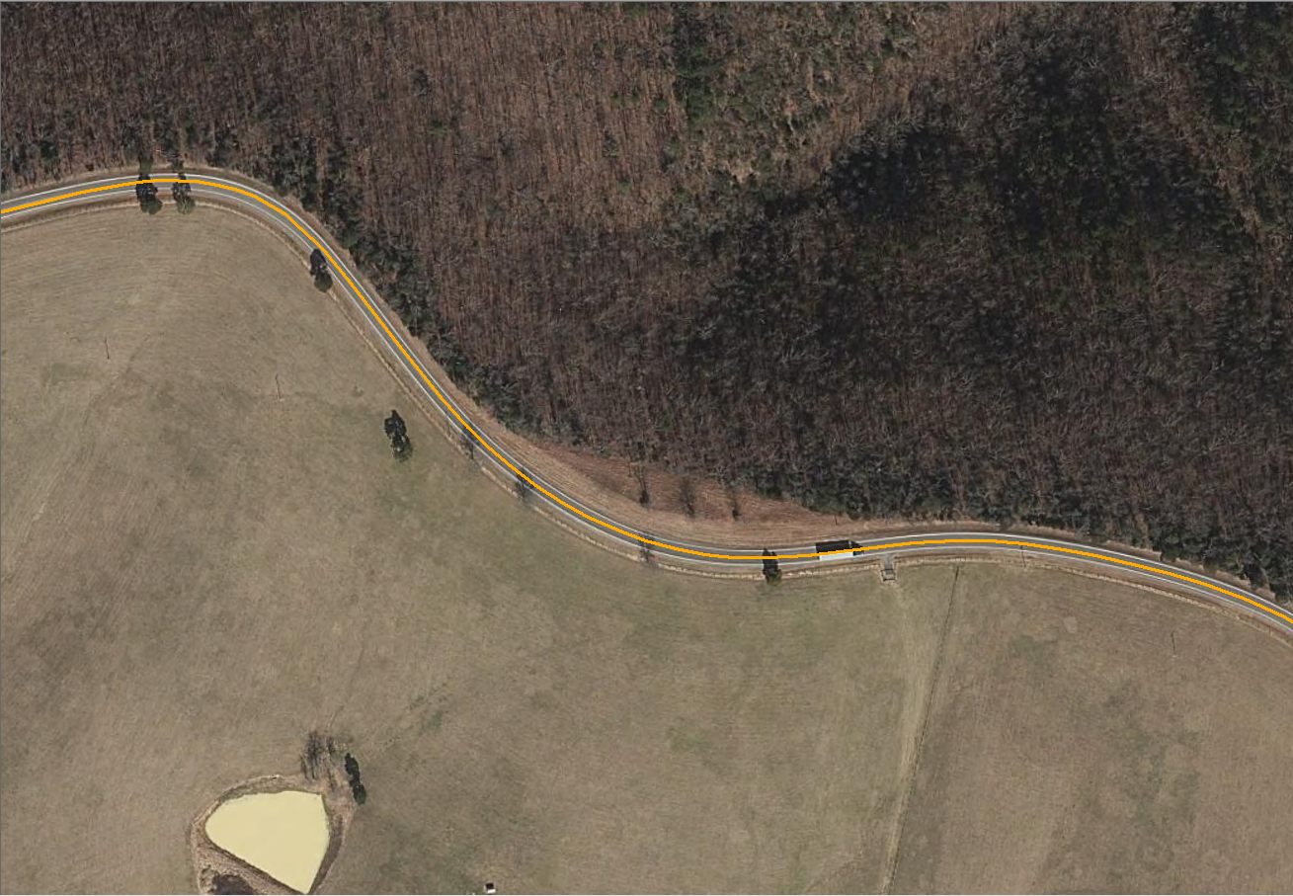
A CLOSER LOOK…Then and Now
Road Edition
SOMEWHERE

Slide 14
HOW DO WE DO THIS?
Notes:
Thank You! Glad to be a part of this presentation today and share a little bit about our Intersection Manager experience. At GIS-T 2017 in Phoenix, AZ we saw a very similar presentation to what Jessie and Lauren had just given. From everything we knew about the MIRE FDE intersections requirements, this tool seemed like it would offer us the dynamic, organized, and easily maintainable environment that we had been wanting for our intersection program. Notice that the title slide shows the intersection of ARNOLD and MIRE FDE. It is imperative to our methodology that the ARNOLD dataset be the foundation for our intersections. Intersections have to be just as dynamic and able to “roll with the changes” as ARNOLD is. Let’s dig in!

Slide 15
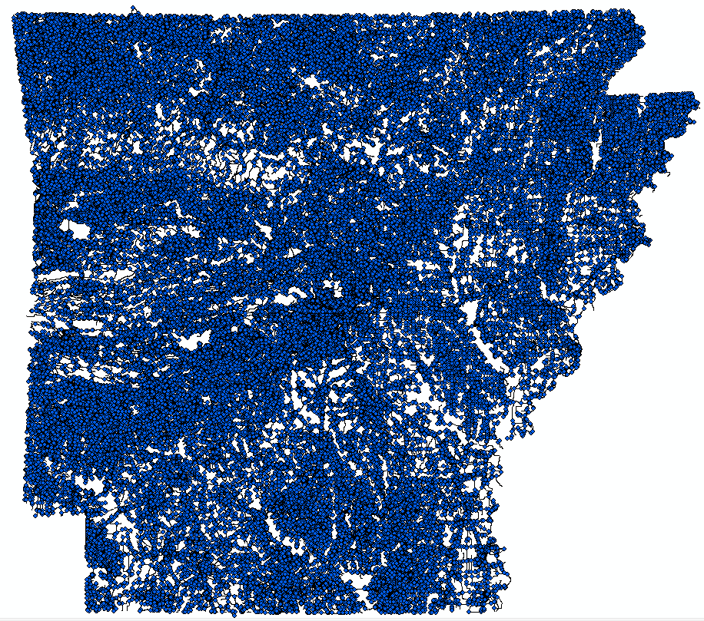
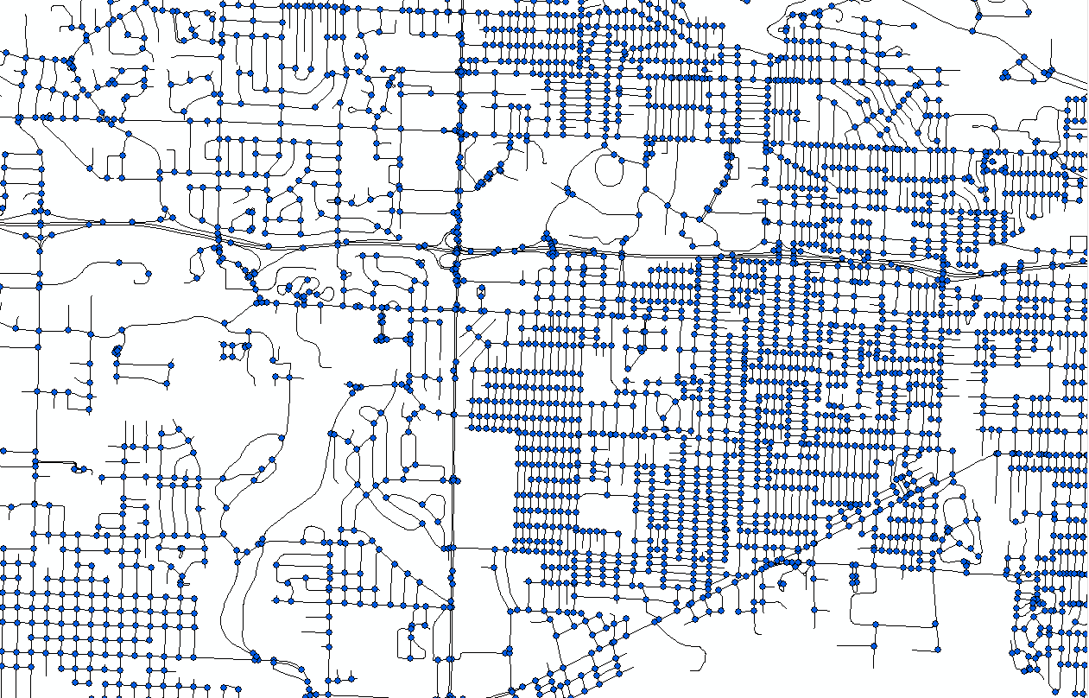
LOCATING THE INTERSECTION
SO MANY INTERSECTIONS!
240,453 Intersections on initial run
Notes:
There’s really only “one BIG run” to do when you decide to officially identify your all public roads intersections. From there, Intersection Manager uses the “from” and “to” dates (temporal fields) in all needed datasets such as ARNOLD and Functional Class to identify attribute changes or new or retired intersections. Knowing this, we have been running a few tests before we decide to capture the statewide intersection and maintain from that point.
Notice that we had over 240,000 intersections created on our initial run which took 2 hours and 50 minutes to generate statewide. Let’s look at some of the discoveries after this run.

Slide 16
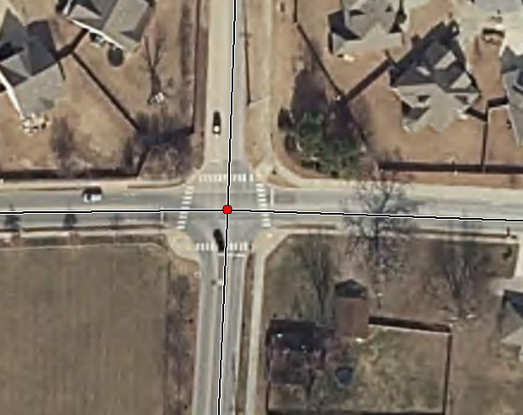
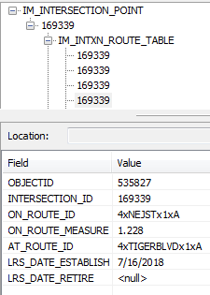
LOCATING THE INTERSECTION
SO MUCH MORE THAN JUST A POINT!
NE J St.
Tiger Blvd.
Tiger Blvd.
NE J St.
Unique Junction Identifier
Notes:
Let’s take a look at this intersection of Tiger Blvd. and NE J St. 1st thing to notice is the unique junction identifier (a MIRE FDE requirement). These are auto-numbered ids. Notice in the intersection route table field how the same intersection ID is noted for each intersection road.

Slide 17
LOCATING THE INTERSECTION
SO MUCH MORE THAN JUST A POINT!
NE J St.
Tiger Blvd.
Tiger Blvd.
NE J St.
Location Identifier for Road 1 Crossing Point
Notes:
Here you can see the identifier for intersecting routes (on_route and at_route). Additionally, notice how a log mile or route measure is present for the on route so that these have a linear location.

Slide 18
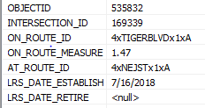
LOCATING THE INTERSECTION
SO MUCH MORE THAN JUST A POINT!
NE J St.
Tiger Blvd.
Tiger Blvd.
NE J St.
Location Identifier for Road 2 Crossing Point
Notes:
These shows the same as the previous slide, but showing the attributes for the other intersecting route. Again, meeting 2 more required data elements for the MIRE intersection FDEs.

Slide 19
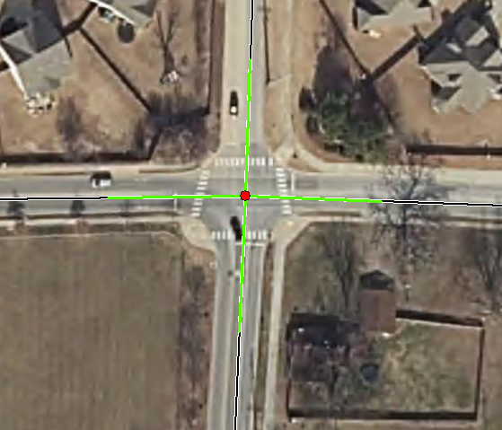
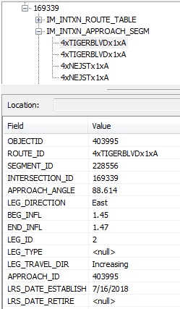
LOCATING THE INTERSECTION
SO MUCH MORE THAN JUST A POINT!
NE J St.
Tiger Blvd.
Tiger Blvd.
Notice how the unique
Intersection ID is tied to the
approach segments
NE J St.
Approach Segments – 100ft (ARDOT)
Unique Approach Identifier
Notes:
Intersection Manager also generates approach segments for the intersections at the distance preferred by the user. Here at ARDOT, we chose 100ft as our test segment length. See that Intersection Manager generates the approach angle, direction and begin and end mile posts for the segments.
Again, notice how the Intersection ID is tied to the data throughout the process.

Slide 20
1
2
3
Unique Junction ID
Loc ID for Road 1 Crossing
Point
Loc ID for Road 2 Crossing
Point
4
5
6
Average Daily Traffic
Average Daily Traffic
Year
Unique Approach ID
7
8
Junction Geometry
Traffic Control
Notes:
Going back to this slide from the beginning. Essentially, in 2 hours and 50 minutes we were able to check off 4 of the 8 attributes called for in the requirement. The other 4 are really up to us, right? We collect and maintain the ADT, we have to attribute the junction geometry and traffic control for each intersection.

Slide 21
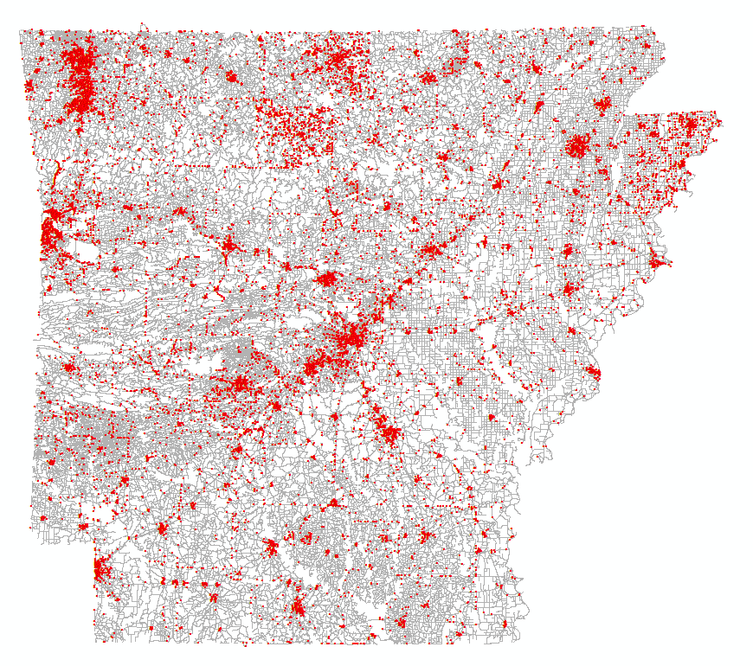
LOCATING THE INTERSECTION
“FALSE INTERSECTIONS”
Look for “pseudonodes”
7% of the initial run
or about 16,000 intersections
Notes:
We noticed some “false” intersections. This is not a fault of Intersection Manager, rather this is the nature of our data. Road change names where there is no true intersection, an overpass or underpass can create a false intersection, etc… We’ve been looking at the pseudonodes in the data and then determining if an intersection that is also a pseudonode is indeed false. For the most part, that is the case. 7% of the initial run or about 16,000 fall in this category. Let’s take a closer look!

Slide 22
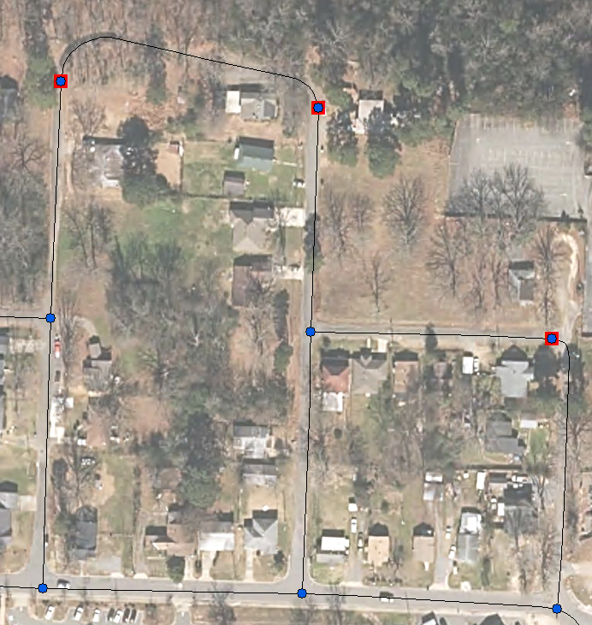
LOCATING THE INTERSECTION
“FALSE INTERSECTIONS”
W. 38th St.
Wilder St.
Lange St.
W. 39th St.
Blunt St.
Notes:
In this screen shot you’ll notice that there are 3 pseudonodes showing in red. Also, notice that the street names are different at each turn, but there are no true intersecting streets. Let’s take a look at one of these in street view.

Slide 23
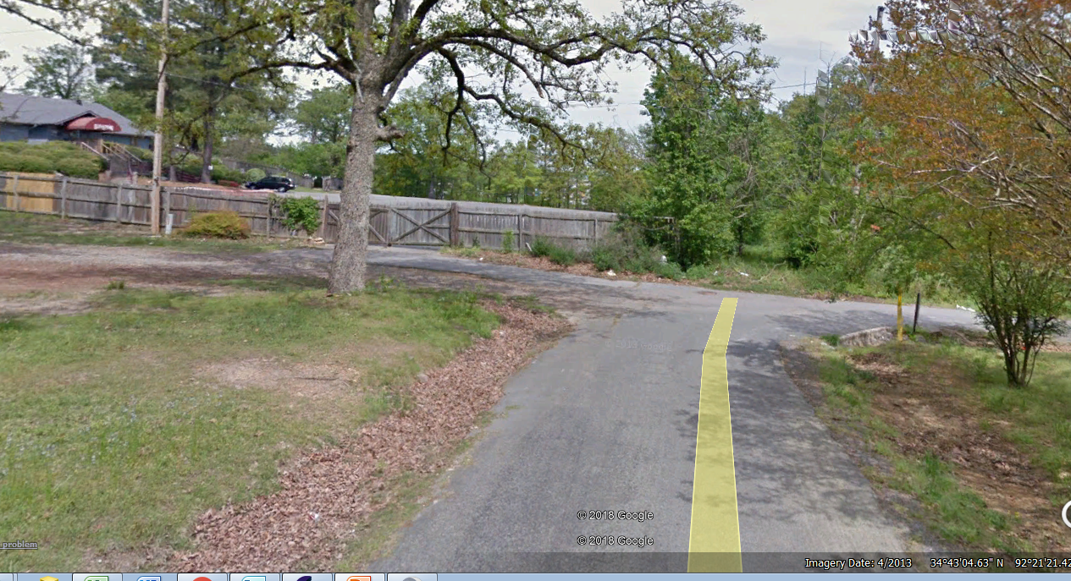
LOCATING THE INTERSECTION
FALSE INTERSECTIONS
Notes:
Notice how this is not a true intersection. This would simply be an intersection that we delete from the dataset.

Slide 24
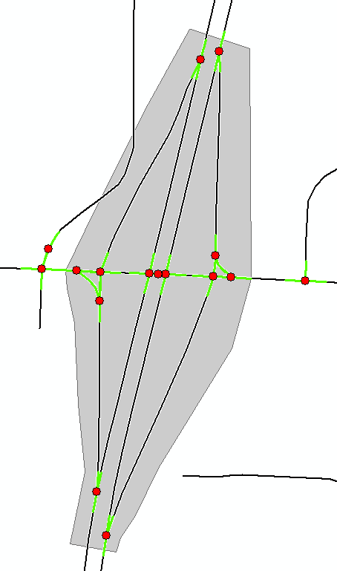
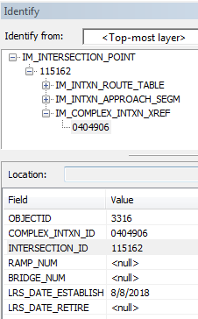
LOCATING THE INTERSECTION
INTERCHANGES/COMPLEX INTERSECTIONS
Notes:
Being able to “marry” our interchange/complex intersection database to the intersections is ideal. Notice how the intersection ID and the Interchange/Complex Intersection ID are both present in the data.

Slide 25
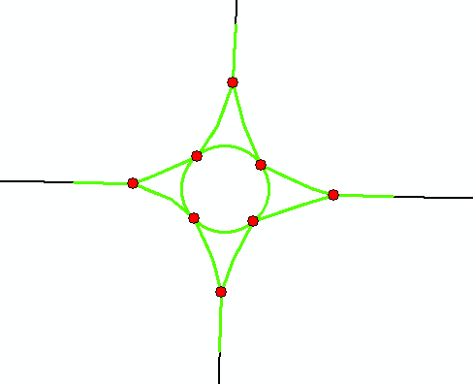
LOCATING THE INTERSECTION
INTERCHANGES/COMPLEX INTERSECTIONS
Notes:
We are still defining what we want to consider complex intersections. Pictured is a roundabout or traffic circle that we will include as a complex intersection. We need to find personnel and have absolute rules on how to draw these.

Slide 26
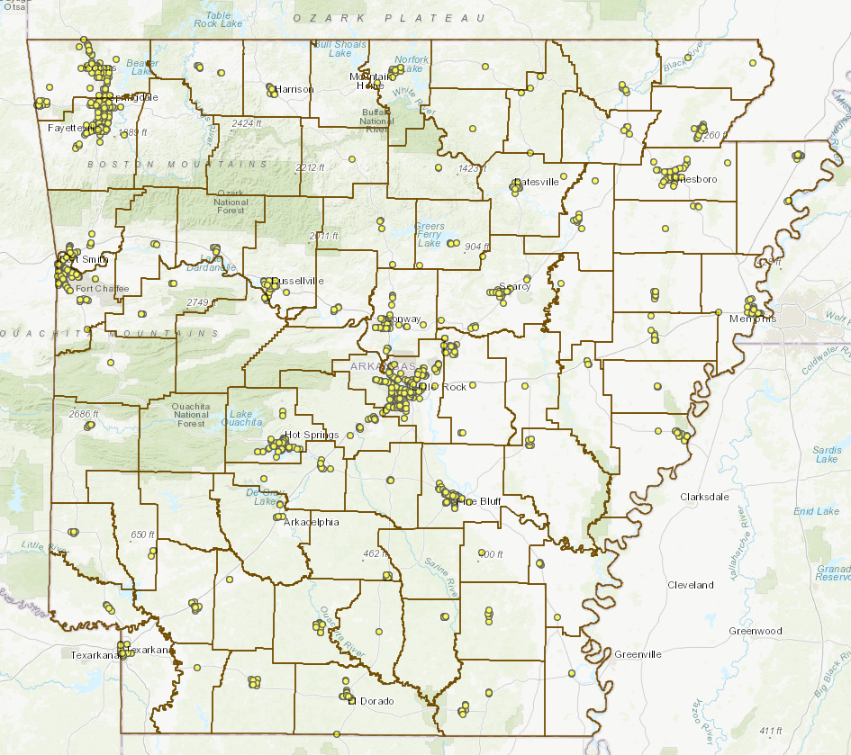
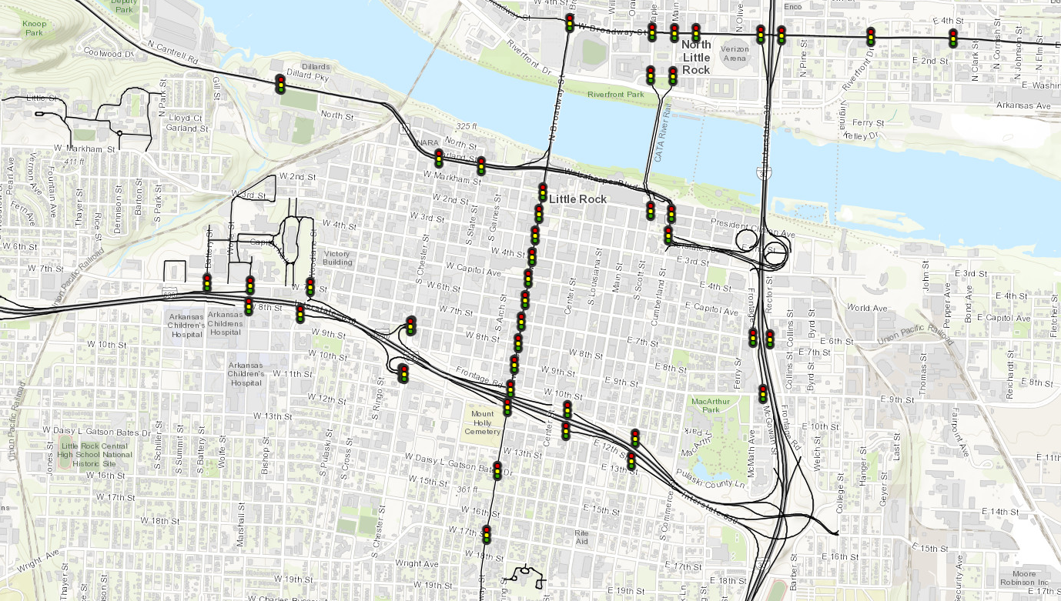
LOCATING THE INTERSECTION
Traffic Control
Notes:
Junction Geometry and Traffic Control are up to us! What will it take to do this? Personnel? Time? Rules?

Slide 27
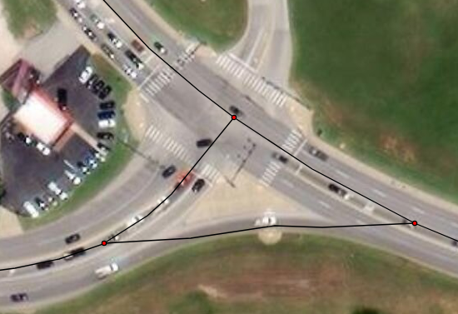
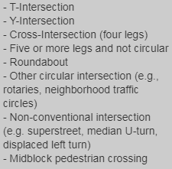
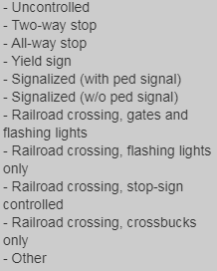
LOCATING THE INTERSECTION
Junction Geometry and Traffic Control
Junction Geometry
Traffic Control
Determining the best approach to attribute these…
Notes:
Junction Geometry and Traffic Control are up to us! What will it take to do this? Personnel? Time? Rules?

Slide 28
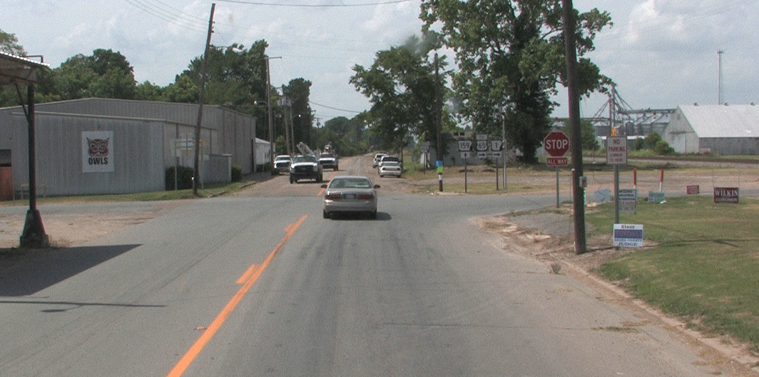
LOCATING THE INTERSECTION
Junction Geometry and Traffic Control
Notes:
Junction Geometry and Traffic Control are up to us! What will it take to do this? Personnel? Time? Rules?

Slide 29
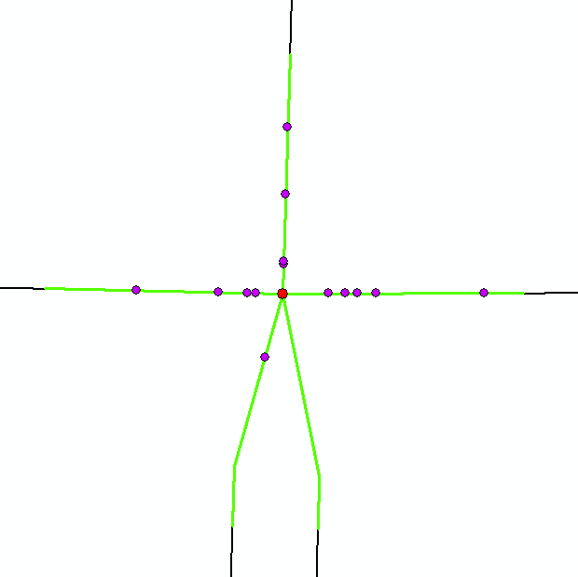
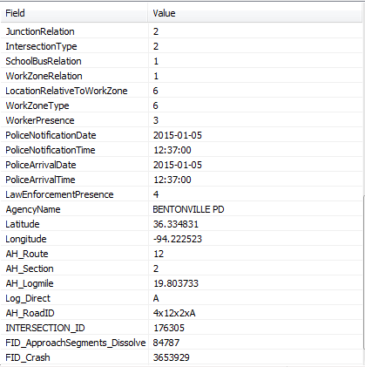
LOCATING THE INTERSECTION
Intersection/Crash Analysis
Prioritizing the intersections….
Notes:
Our administration is excited about analyzing the intersections and the crash database for safety analysis. By spatially intersecting the crashes that fall with the approach segments, we can identify intersections that we need to possibly prioritize for studies and improvements.

Slide 30
LOCATING THE INTERSECTION
Just the Facts – Overview
Purchased Transcend Spatial Solutions Intersection Manager Software – Nov. 2017
Soft roll-out/methodology – March 2018
Presentation of initial software results to administration– August 2018
Official run – April 2019
Starting to fill in the gaps:
Interchanges
Complex Intersections
Traffic Control
False Intersections
Retiring Intersections
Intersection Geometry
Approach Segment Length
Analyzing Intersections with Crash Data
Notes:
Overview of the discussion

Slide 31
THANK YOU!

